Slide 1
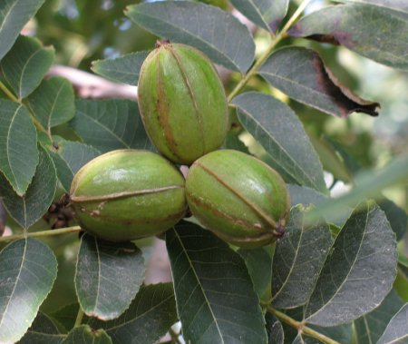
Juglandaceae
“The Walnut Family”
Jennifer Ringgold

Slide 2
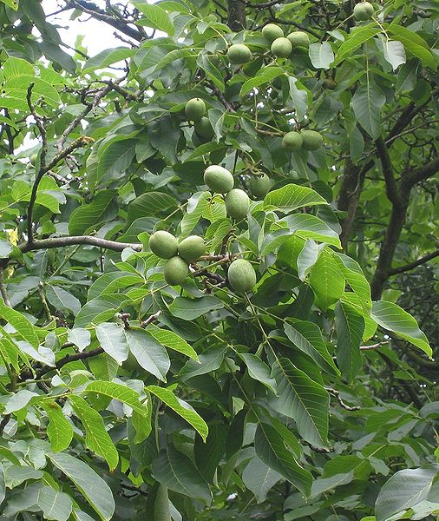
Genera
8 different genera (60 species)
Cyclocarya Iljinsk — (wheel wingnut)
Juglans L. — (walnut)
Pterocarya Kunth — (wingnut)
Carya Nutt. — (hickory and pecan)
Platycarya Siebold & Zucc.
Alfaroa Standl. — (gualin)
Engelhardia Lesch. ex Blume — (cheo)
Oreomunnea Oerst.
http://www.plantsystematics.org/users/jdelaet/3_4_06_2/oeploa137/nDSC_0014.JPG

Slide 3
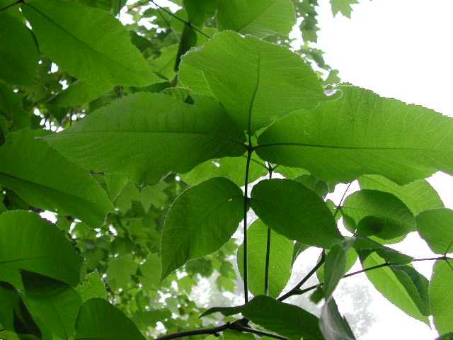
Juglandaceae “The Walnut Family”
Mostly trees, few shrubs
Large amounts of this family are found Native to Eurasia, Americas, and Southeast Asia
LEAVES
Aromatic
Alternate
Pinnately compound
20-100cm long
http://www.colby-sawyer.edu/images/image_1213.jpg

Slide 4
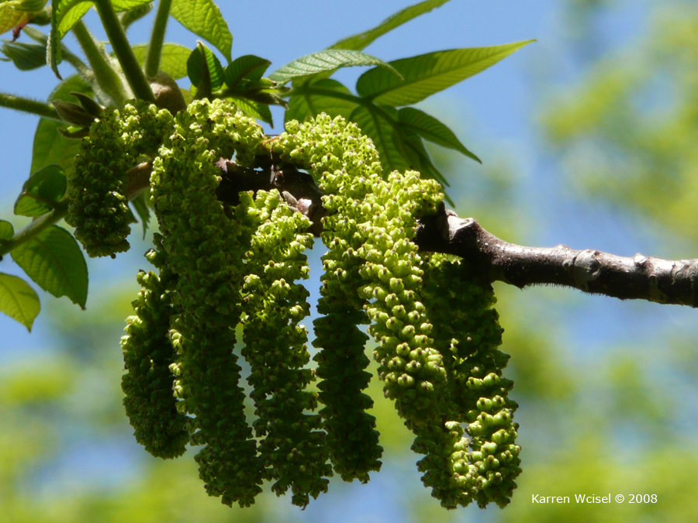
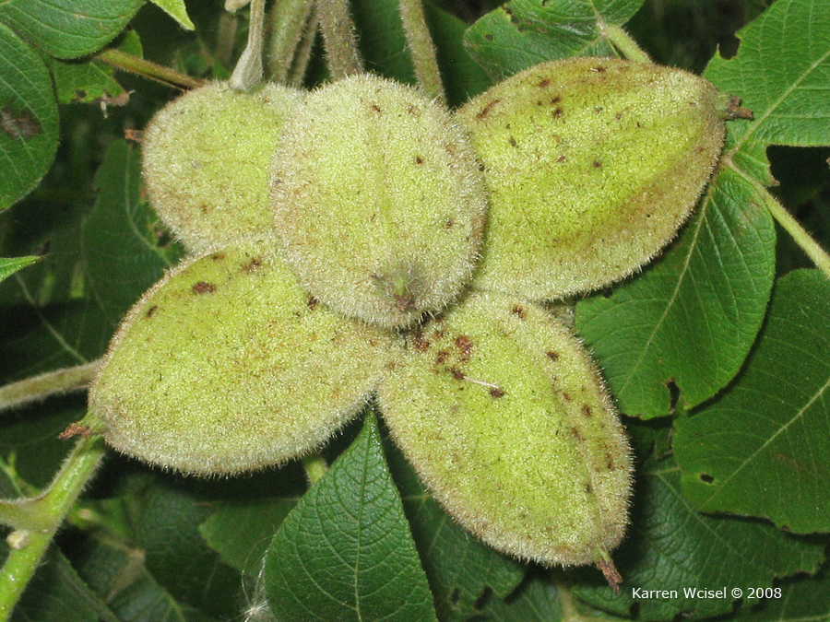
Butternut Cucurbita moschata
Alternate leaves, Pinnately compound
Leaflets of 11-17
Smells of Juglone
Drooping clusters of sweet fruit covered in small hairs containing nuts-used in baking
40' - 60' feet
http://www.treetopics.com/juglans_cinerea/butternut_P1030707.jpg
http://images.google.com/imgres?imgurl=http://www.treetopics.com/juglans_cinerea/butternut

Slide 5
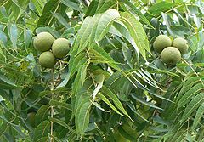
Black Walnut Juglans nigra
Alternate, Pinnately compound 30-60 cm long
Fruit (nut) with a brownish-green, semi-fleshy husk
Smells of Juglone
Wood is used to make furniture, flooring, and rifle stocks, and oil is pressed from the seeds.
30–40 feet
http://upload.wikimedia.org/wikipedia/commons/d/de/Black_Walnut_nut_and_leave_detail.JPG

Slide 6
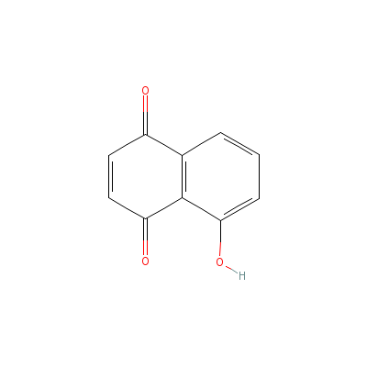
Juglone
Alleopathic compound, meaning it is synthesized by one type of plant and affects the growth of another.
Aromatic organic compound with the molecular formula C₁₀H₆O₃
Occurs naturally in the leaves, roots, husks, and bark of plants in the Juglandaceae family
http://www.impgc.com/images/Structures/Juglone.gif

Slide 7
References
Text
Manos, P. S., aand D. E. Stone 2001. "Evolution, phylogeny and systematics of the Juglandaceae." Annals of the Missouri Botanical Garden
Petrides, G. A. and Wehr, J. (1998). Eastern Trees. Houghton Mifflin Company.
Walters, Dirk., Keil, David., Murrell, Zack. 2006. Vascular Plant Taxonomy.
5th ed. U.S; Kendall/Hunt.
Pictures
http://www.agroatlas.ru/content/related/Juglans_regia/Juglans_regia.jpg
http://images.google.com/imgres?imgurl=http://www.treetopics.com/juglans_cinerea/butternut
http://www.colby-sawyer.edu/images/image_1213.jpg
http://www.plantsystematics.org/users/jdelaet/3_4_06_2/oeploa137/nDSC_0014.JPG
http://images.google.com/imgres?imgurl=http://www.treetopics.com/juglans_cinerea/butternut
http://upload.wikimedia.org/wikipedia/commons/d/de/Black_Walnut_nut_and_leave_detail.JPG
http://www.impgc.com/images/Structures/Juglone.gif

